Slide 1

BLE SMART VENTS
Notes:
It is using the background from https://dribbble.com/shots/1588545--Freebie-7-Low-Poly-Backgrounds-svg-png
Template modified by fppt.com

Slide 2
INTRODUCTION
The goal was to give homeowners:
more control over how their heating & cooling systems
an increase in the efficiency & effectiveness of traditional HVAC systems
a design utilizing for systems using a singular furnace.

Slide 3
TECHNOLOGY
A smart vent includes:
standard-sized vent registers (4″x10″)
bluetooth-capable microcontroller (RSL15 development board from Onsemi)
temperature & humidity sensors (Mikroe-3436 HDC2080)
a motor-controlled closing mechanism (FS90 Servo motor).

Slide 4
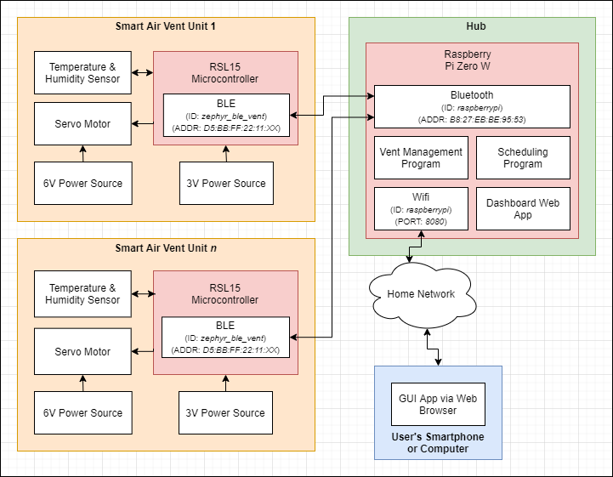
METHODOLOGY
These Vents connect to the central Hub unit, which maintains the system through the user- directed schedule and provides a GUI dashboard for system monitoring.

Slide 5
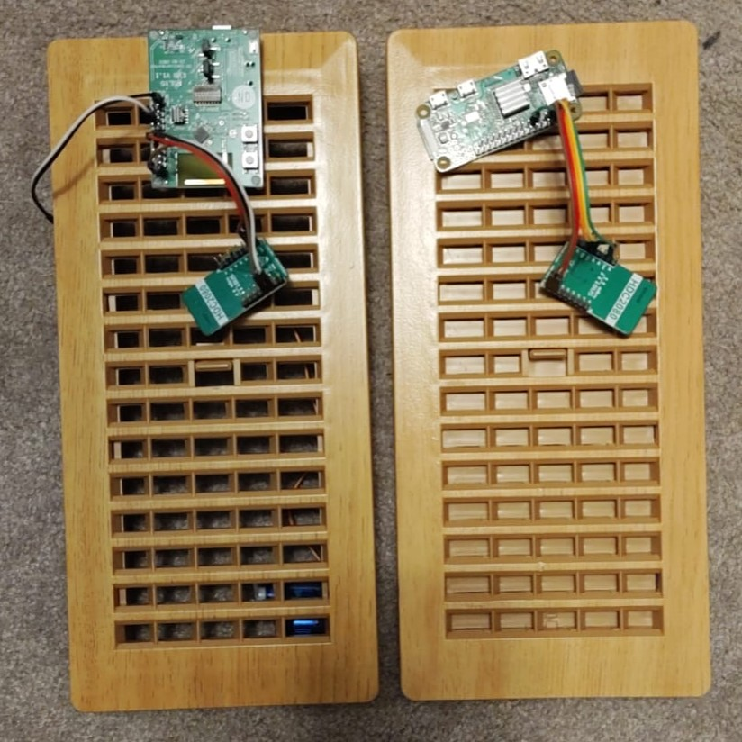
METHODOLOGY

Slide 6
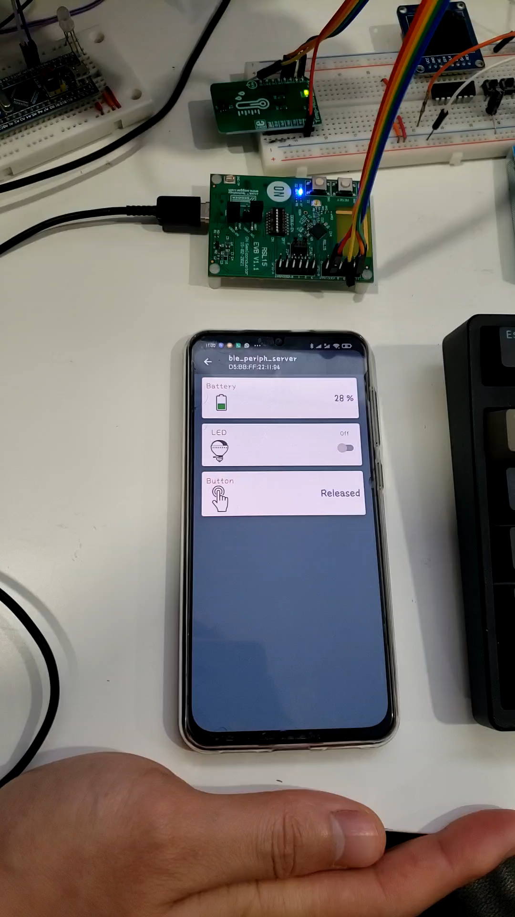
METHODOLOGY
A humidity sensor and a temperature sensor are integrated into HDC2080 device which is controlled by RSL15 over I2C communication.
Bluetooth has been used for the connection of mobile application from hub to vent unit.

Slide 7
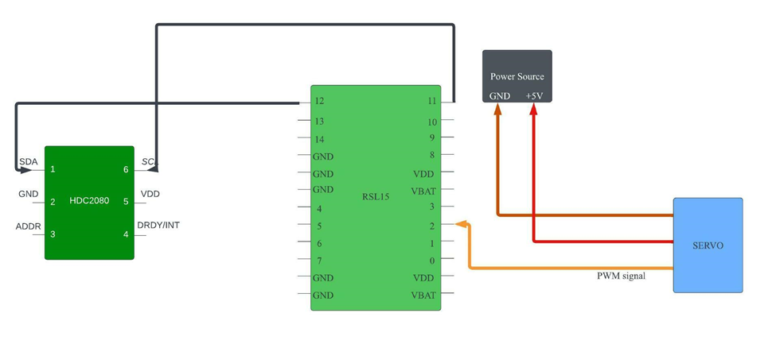
METHODOLOGY

Slide 8
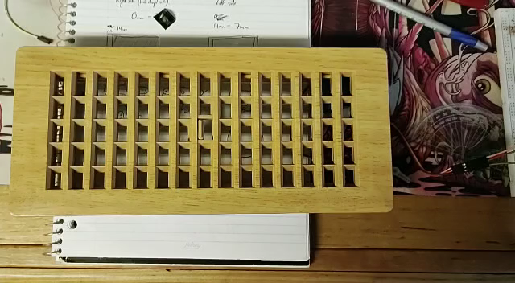
METHODOLOGY
The servo motor controlling opening/closing mechanism can be done by using PWM peripheral function.

Slide 9
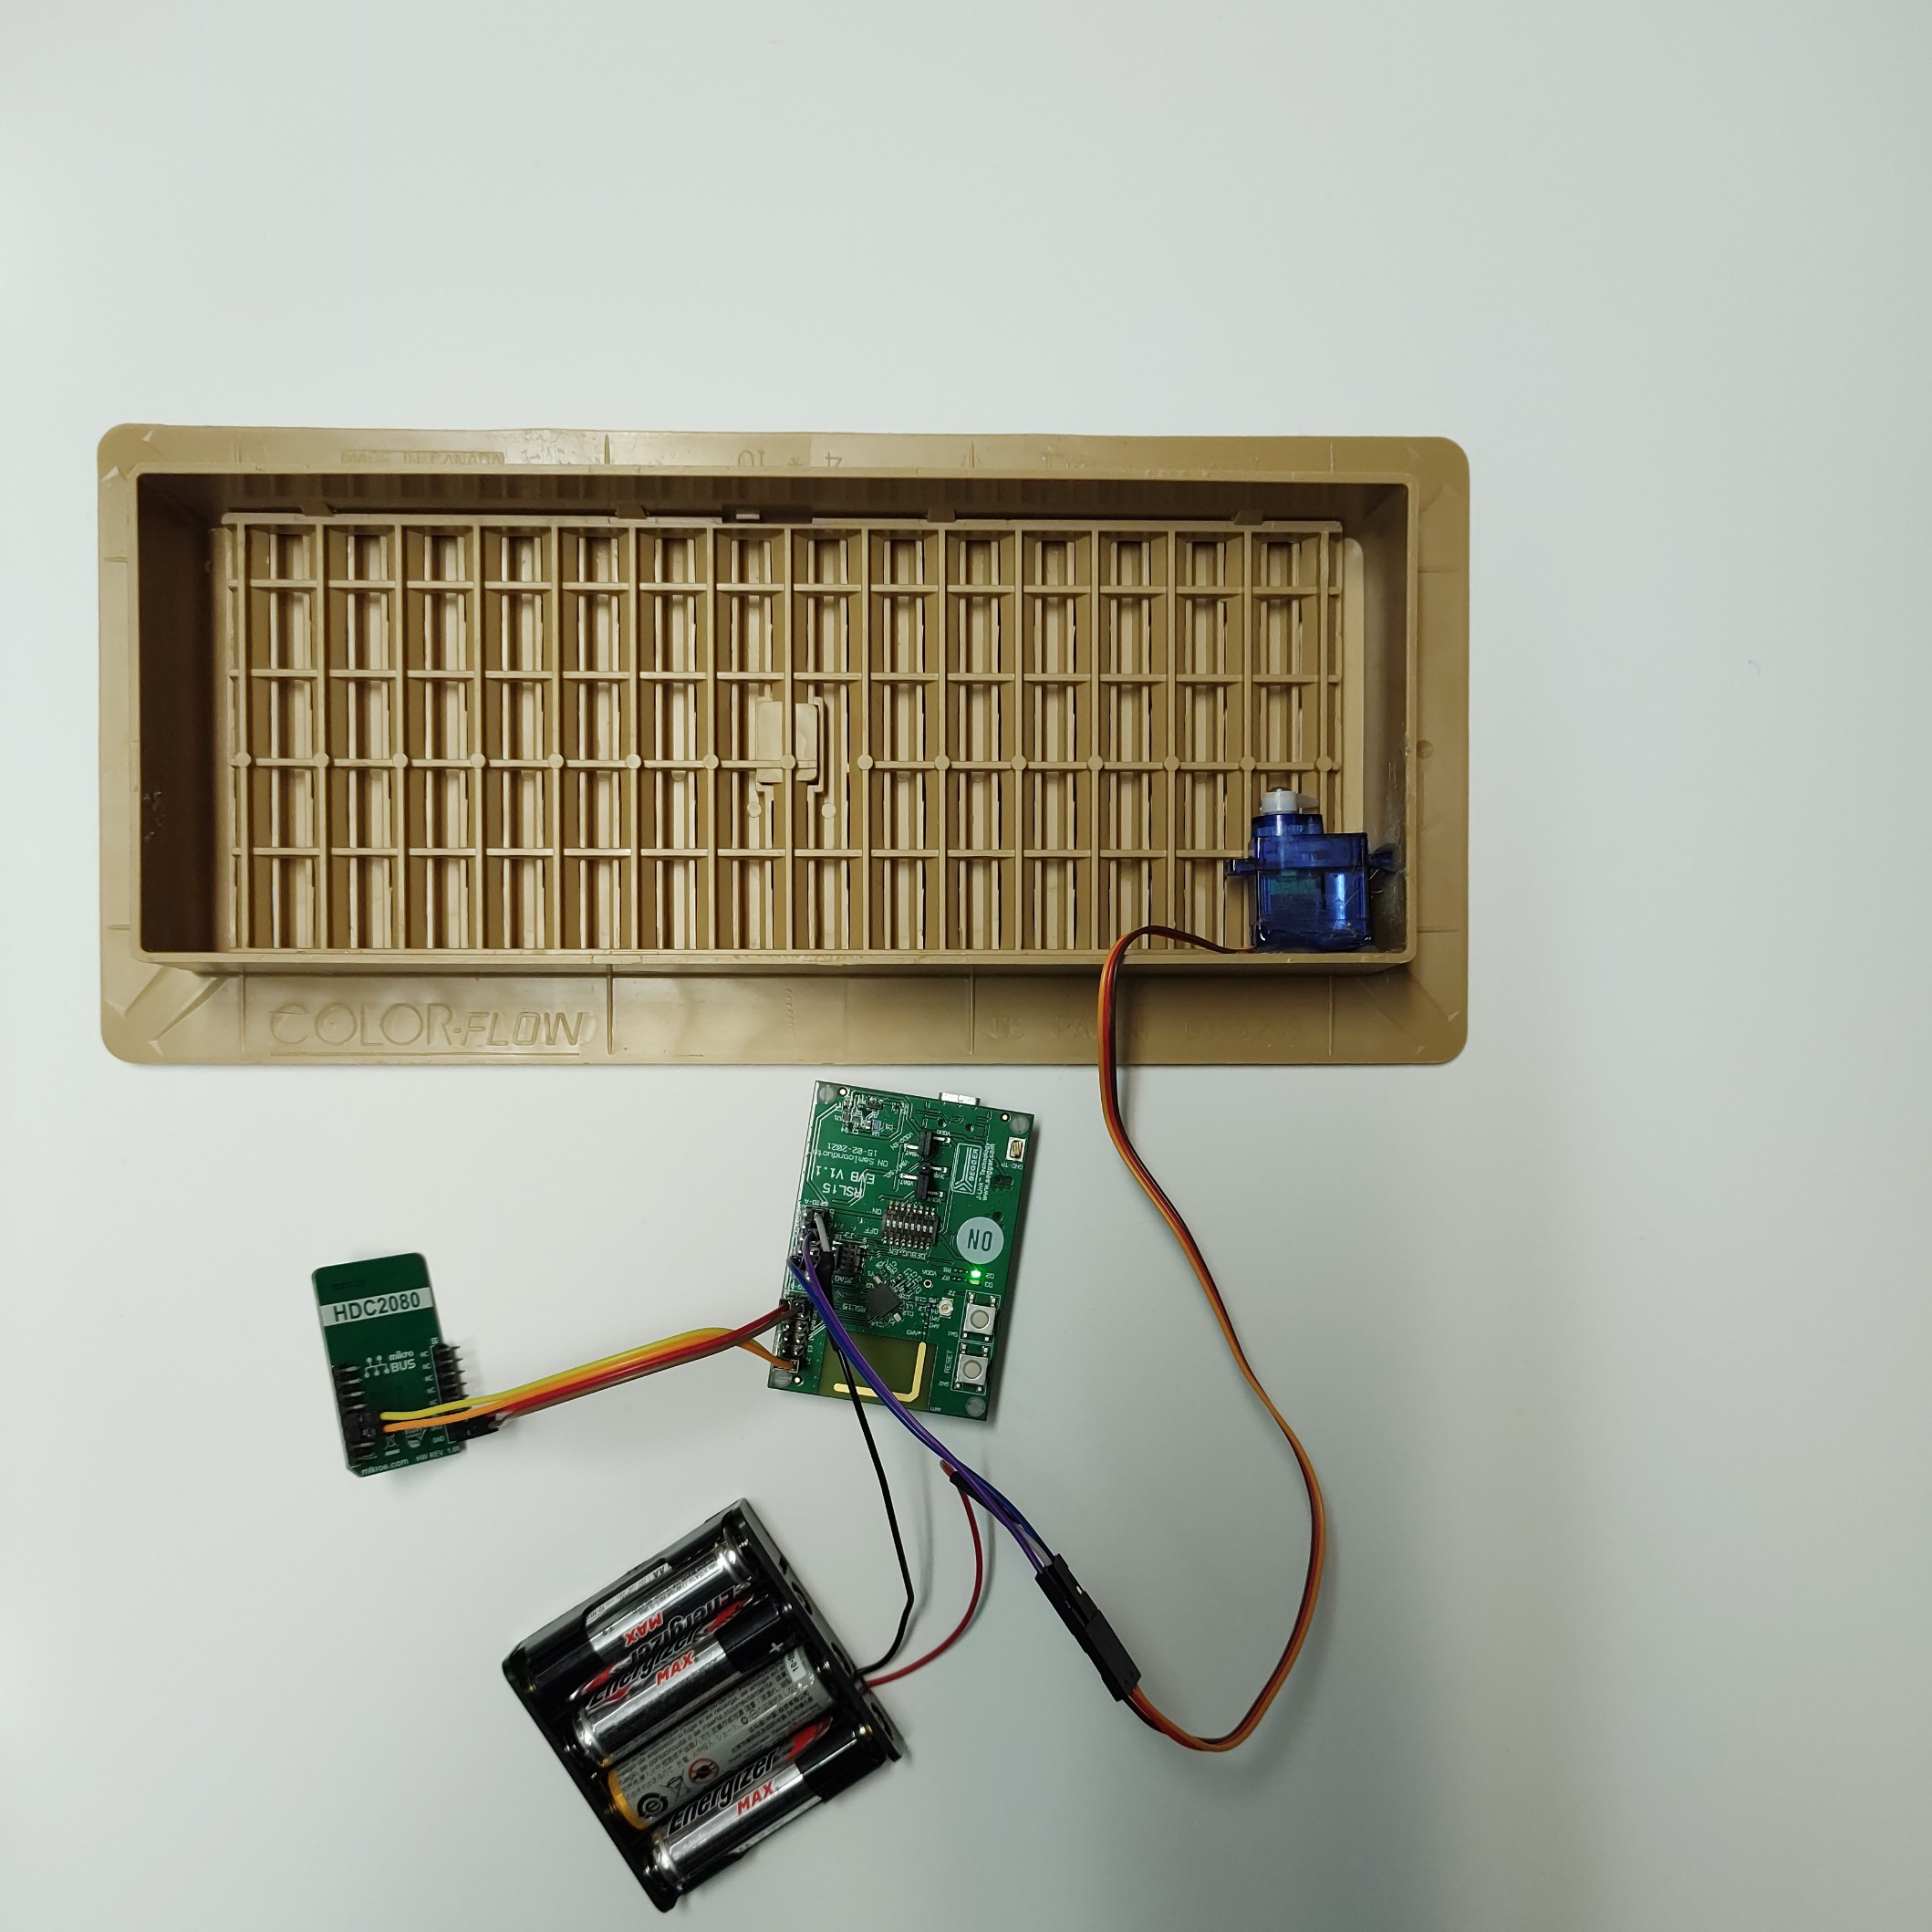
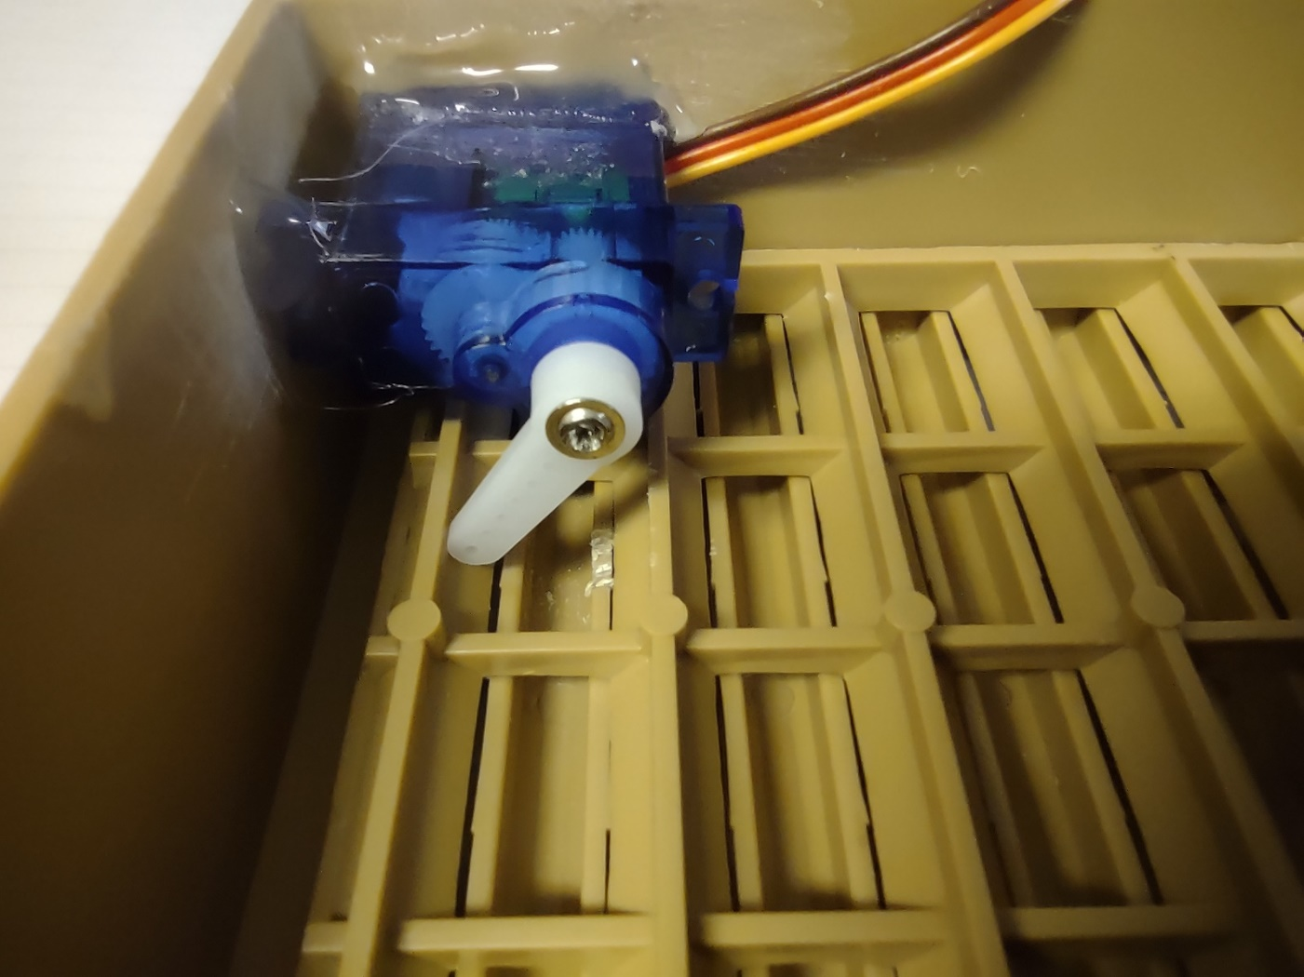
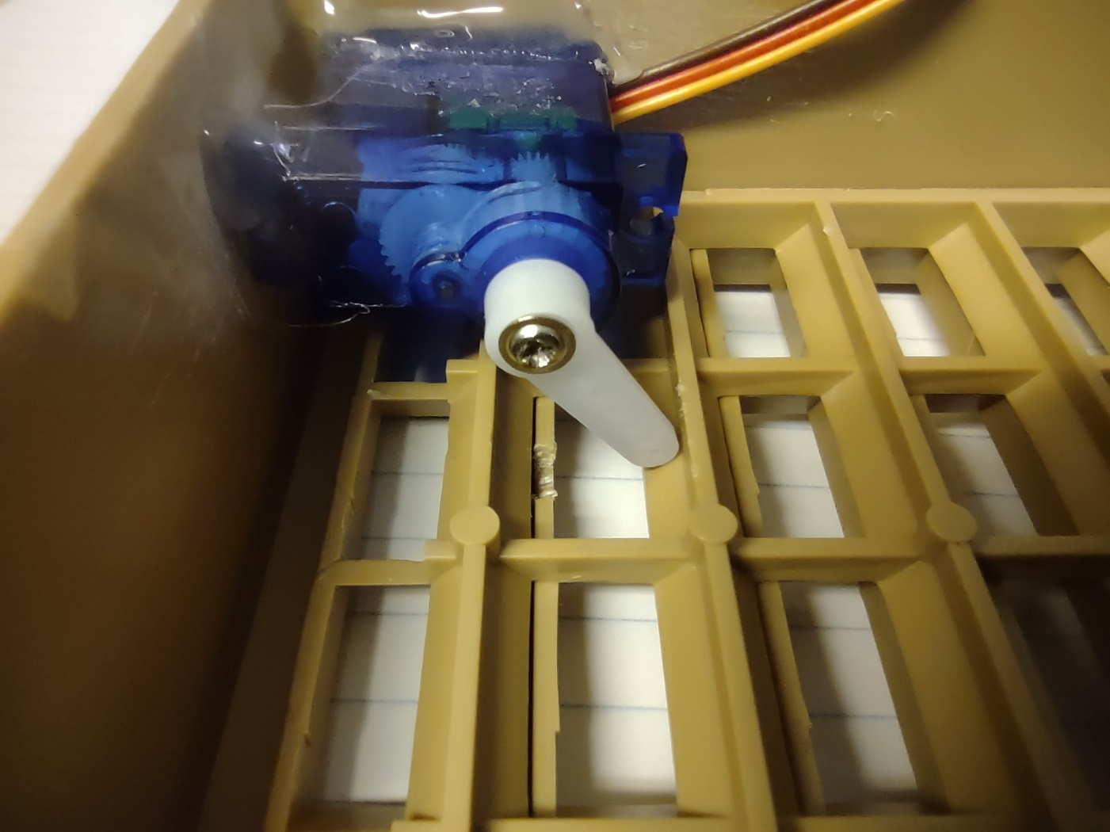
METHODOLOGY

Slide 10
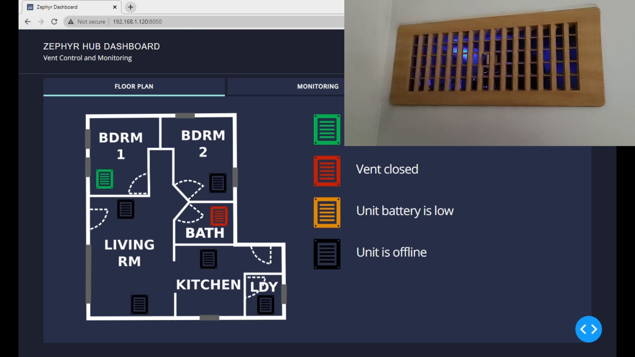
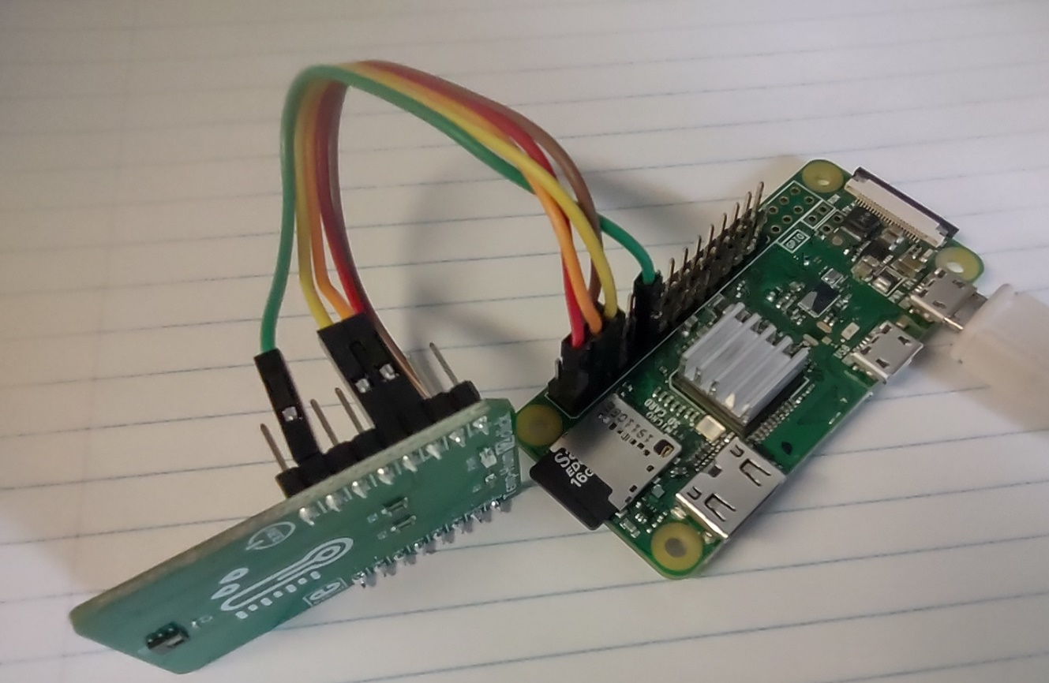
METHODOLOGY
For the hub unit, python has been used to perform the operation over raspberry pi.

Slide 11
RESULTS
In our tests, we used a small single-vented bathroom to maintain the room temperature at 22°C with a hysteresis of 1°C, and collected three sets of data over of three days.
For the first set of data, we opened the vent register fully and left it open, collecting temperature readings at 1-minute intervals for 24 hours.
For the second set, we closed the vent register fully and again collected temperature readings for 24 hours at 1-minute intervals.
And for the third set of data, we again collected data at 1-minute intervals for 24 hours; however, for this set, we used our automated Vent unit to open and close the vent throughout the collection period.

Slide 12
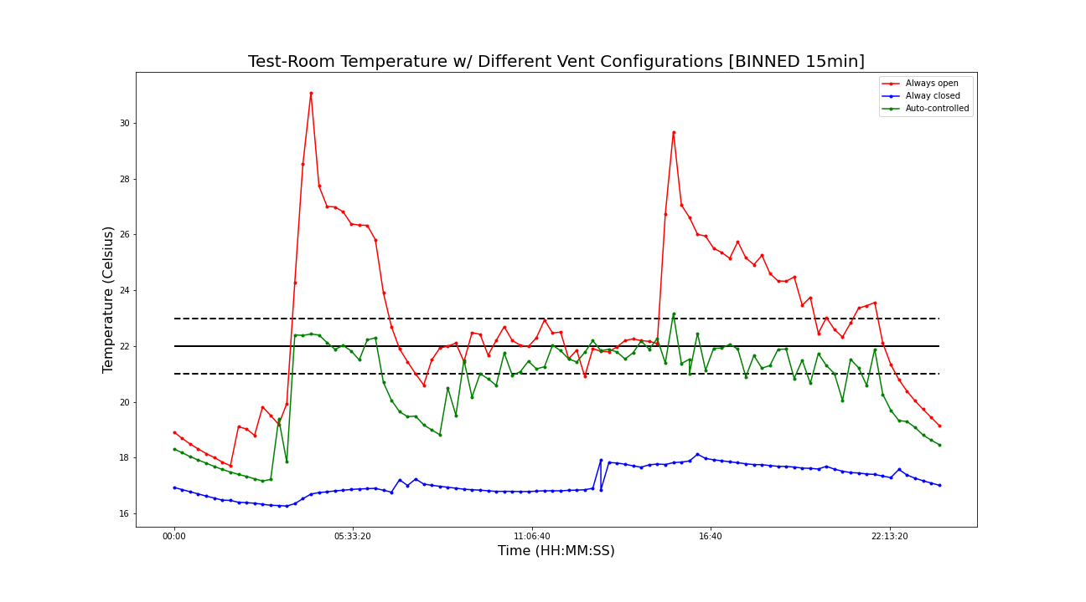
RESULTS

